Slide 1
FAKE NEWS DETECTION
Machine Learning Project
Made by: DEPANDRA YADAV
ASHWANI CHAUDHARY
GROUP- 53

Slide 2


Slide 3
OVERVIEW
INTRODUCTION
PROBLEM DEFINATION
TYPES OF DATA IN SOCIAL MEDIA POST
TYPES OF FAKE NEWS AND PATTERN
METHODOLOGY
TEXT PRE- PROCESSING
IN DEPTH TEXT PRE – PROCESSING
RESULT AND ANALYSIS

Slide 4
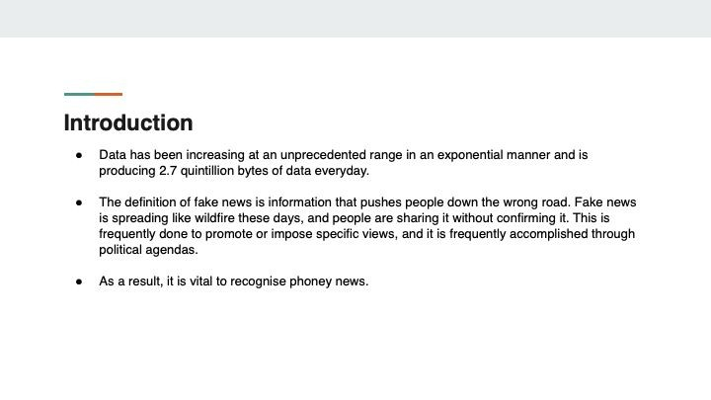
Introduction

Slide 5
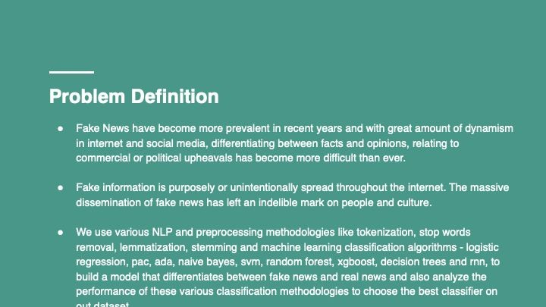

Slide 6
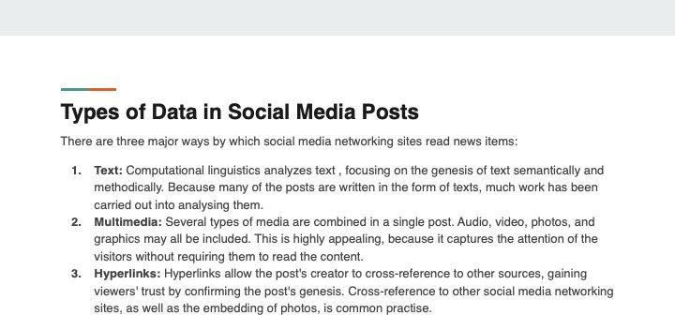

Slide 7
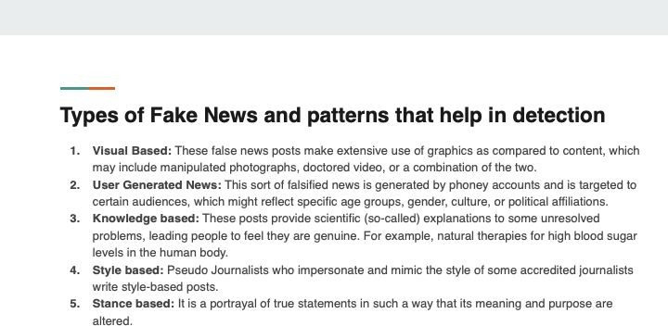

Slide 8
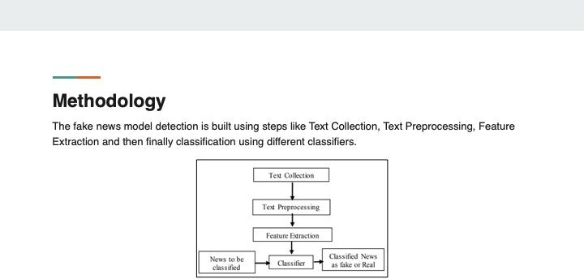

Slide 9
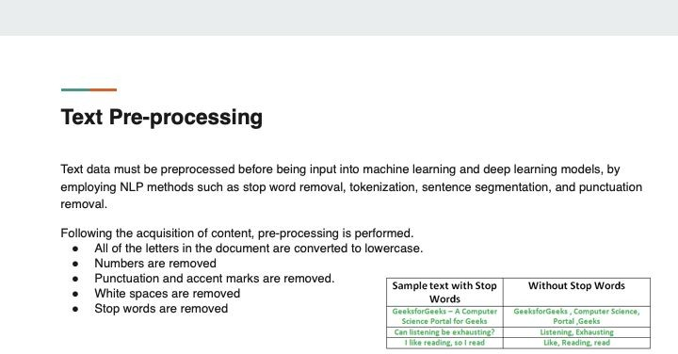

Slide 10
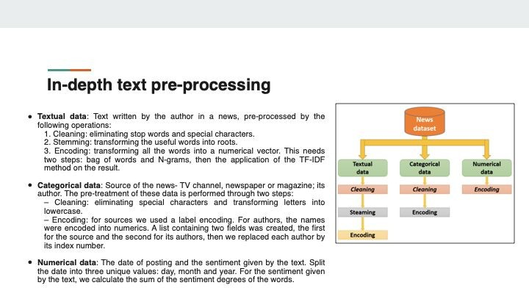

Slide 11
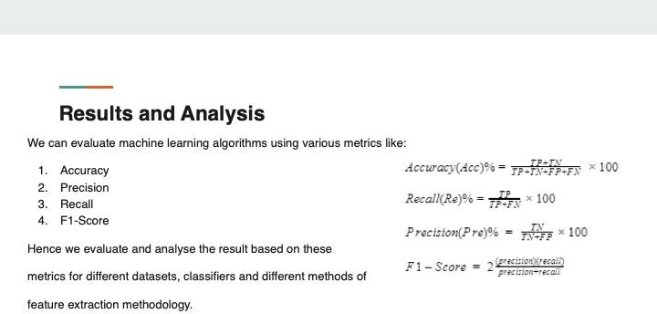

Slide 12
CONCLUSION
Due to increasing use of internet, it is now easy to spread fake news. A huge number of persons
are regularly connected with internet and social media platforms. There is no any restriction while
posting any news on these platforms. So some of the people takes the advantage of these platforms
and start spreading fake news against the individuals or organizations. This can destroy the repute
of an individual or can affect a business. Through fake news, the opinions of the people can also
be changed for a political party. There is a need for a way to detect these fake news. Machine
learning classifiers are using for different purposes and these can also be used for detecting the
fake news. The classifiers are first trained with a data set called training data set. After that, these
classifiers can automatically detect fake news.
In this systematic literature review, the supervised machine learning classifiers are discussed that
requires the labeled data for training. Labeled data is not easily available that can be used for
training the classifiers for detecting the fake news. In future a research can be on the use of the
unsupervised machine learning classifiers for the detection of fake news.

Slide 13
THANK YOU

